Slide 2
Intel’s Solid-State Drives
Knut Grimsrud
Intel Fellow, Director of Storage Architecture

Slide 3
Getting the Most of Intel® SSD Do’s & Don’ts
DO queue requests to SSD as deeply as possible
SSD has massive internal parallelism and generally is underutilized. Parallelism will further increase over time.
Performance scales well with queue depth
DON’T withhold requests in order to “optimize” or “aggregate” them
Traditional schemes geared towards reducing HDD latencies do not apply. Time lost in withholding requests difficult to make up.
DO worry about software/driver overheads & latencies
At 100K IOPS how does your SW stack measure up?
DON’T use storage “backpressure” to pace activity
IO completion time (or rate) is not a useful pacing mechanism and attempting to use that as throttle can result in tasks generating more activity than desired

Slide 4
Non-Issues to Not Worry About
Block/page sizes, alignments and boundaries
Intel® SSD is insensitive to whether host writes have any relationship to internal NAND boundaries or granularities
Expect other high-performing SSDs to also handle this
Internal NAND structures constantly changing anyway, so chasing this will be a losing proposition
Write transfer sizes & write “globbing”
No need to accumulate writes in order to create large writes
Temporarily logging writes sequentially and later re-locating to final destination unhelpful to Intel SSD (and is detrimental to longevity)
Software “helping” by making near-term assumptions about SSD internals will become a long-term hindrance
Any SW assistance must have longevity

Slide 5
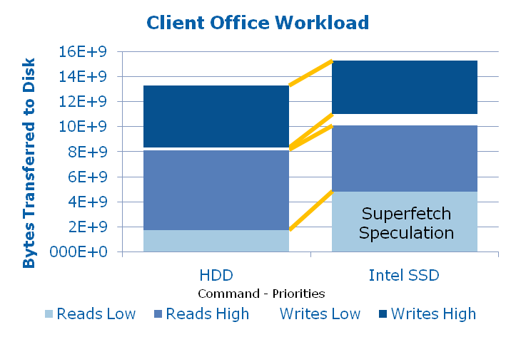
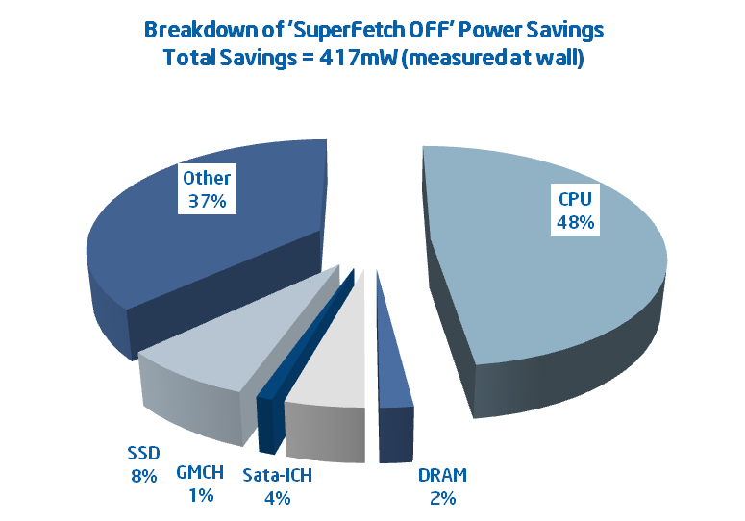
Optimizations Can Be Thwarted Overspeculation with SSDs
Formerly I/O bound processes have no “natural throttle” with fast SSD
Fast I/O frees the CPU to do more, including speculation
25% more read data transferred with fast SSD in this example
Speculation is important when cost of demand fetching is high compared with cost of speculating – which is no longer the case
No performance benefit to the benchmark with SuperFetch on
Speculation without performance benefit is a power loss
Platform power is reduced if SuperFetch is disabled
Indexing
“Other” includes power conversion
Data courtesy of Advanced Platform Architecture, Mobile Products Group

Slide 6
Benefits of Fast Intel® SSD Most Realized with Intense Workloads
The benefits of a faster storage subsystem is most realized with disk-intensive environments that utilize it
* Performance tests and ratings are measured using Dell D830 or HP 6910p SantaRosa notebook 2.0GHz with Merom processor and 2GB DRAM running Vista Enterprise Edition and reflects the approximate performance of Intel products as measured by those tests. Any difference in system hardware or software design or configuration may affect actual performance. Data collected with 50nm NAND. ** Other brands and names are the property of their respective owners

Slide 7
© 2008 Microsoft Corporation. All rights reserved. Microsoft, Windows, Windows Vista and other product names are or may be registered trademarks and/or trademarks in the U.S. and/or other countries.
The information herein is for informational purposes only and represents the current view of Microsoft Corporation as of the date of this presentation. Because Microsoft must respond to changing market conditions, it should not be interpreted to be a commitment on the part of Microsoft, and Microsoft cannot guarantee the accuracy of any information provided after the date of this presentation. MICROSOFT MAKES NO WARRANTIES, EXPRESS, IMPLIED OR STATUTORY, AS TO THE INFORMATION IN THIS PRESENTATION.

